Slide 1

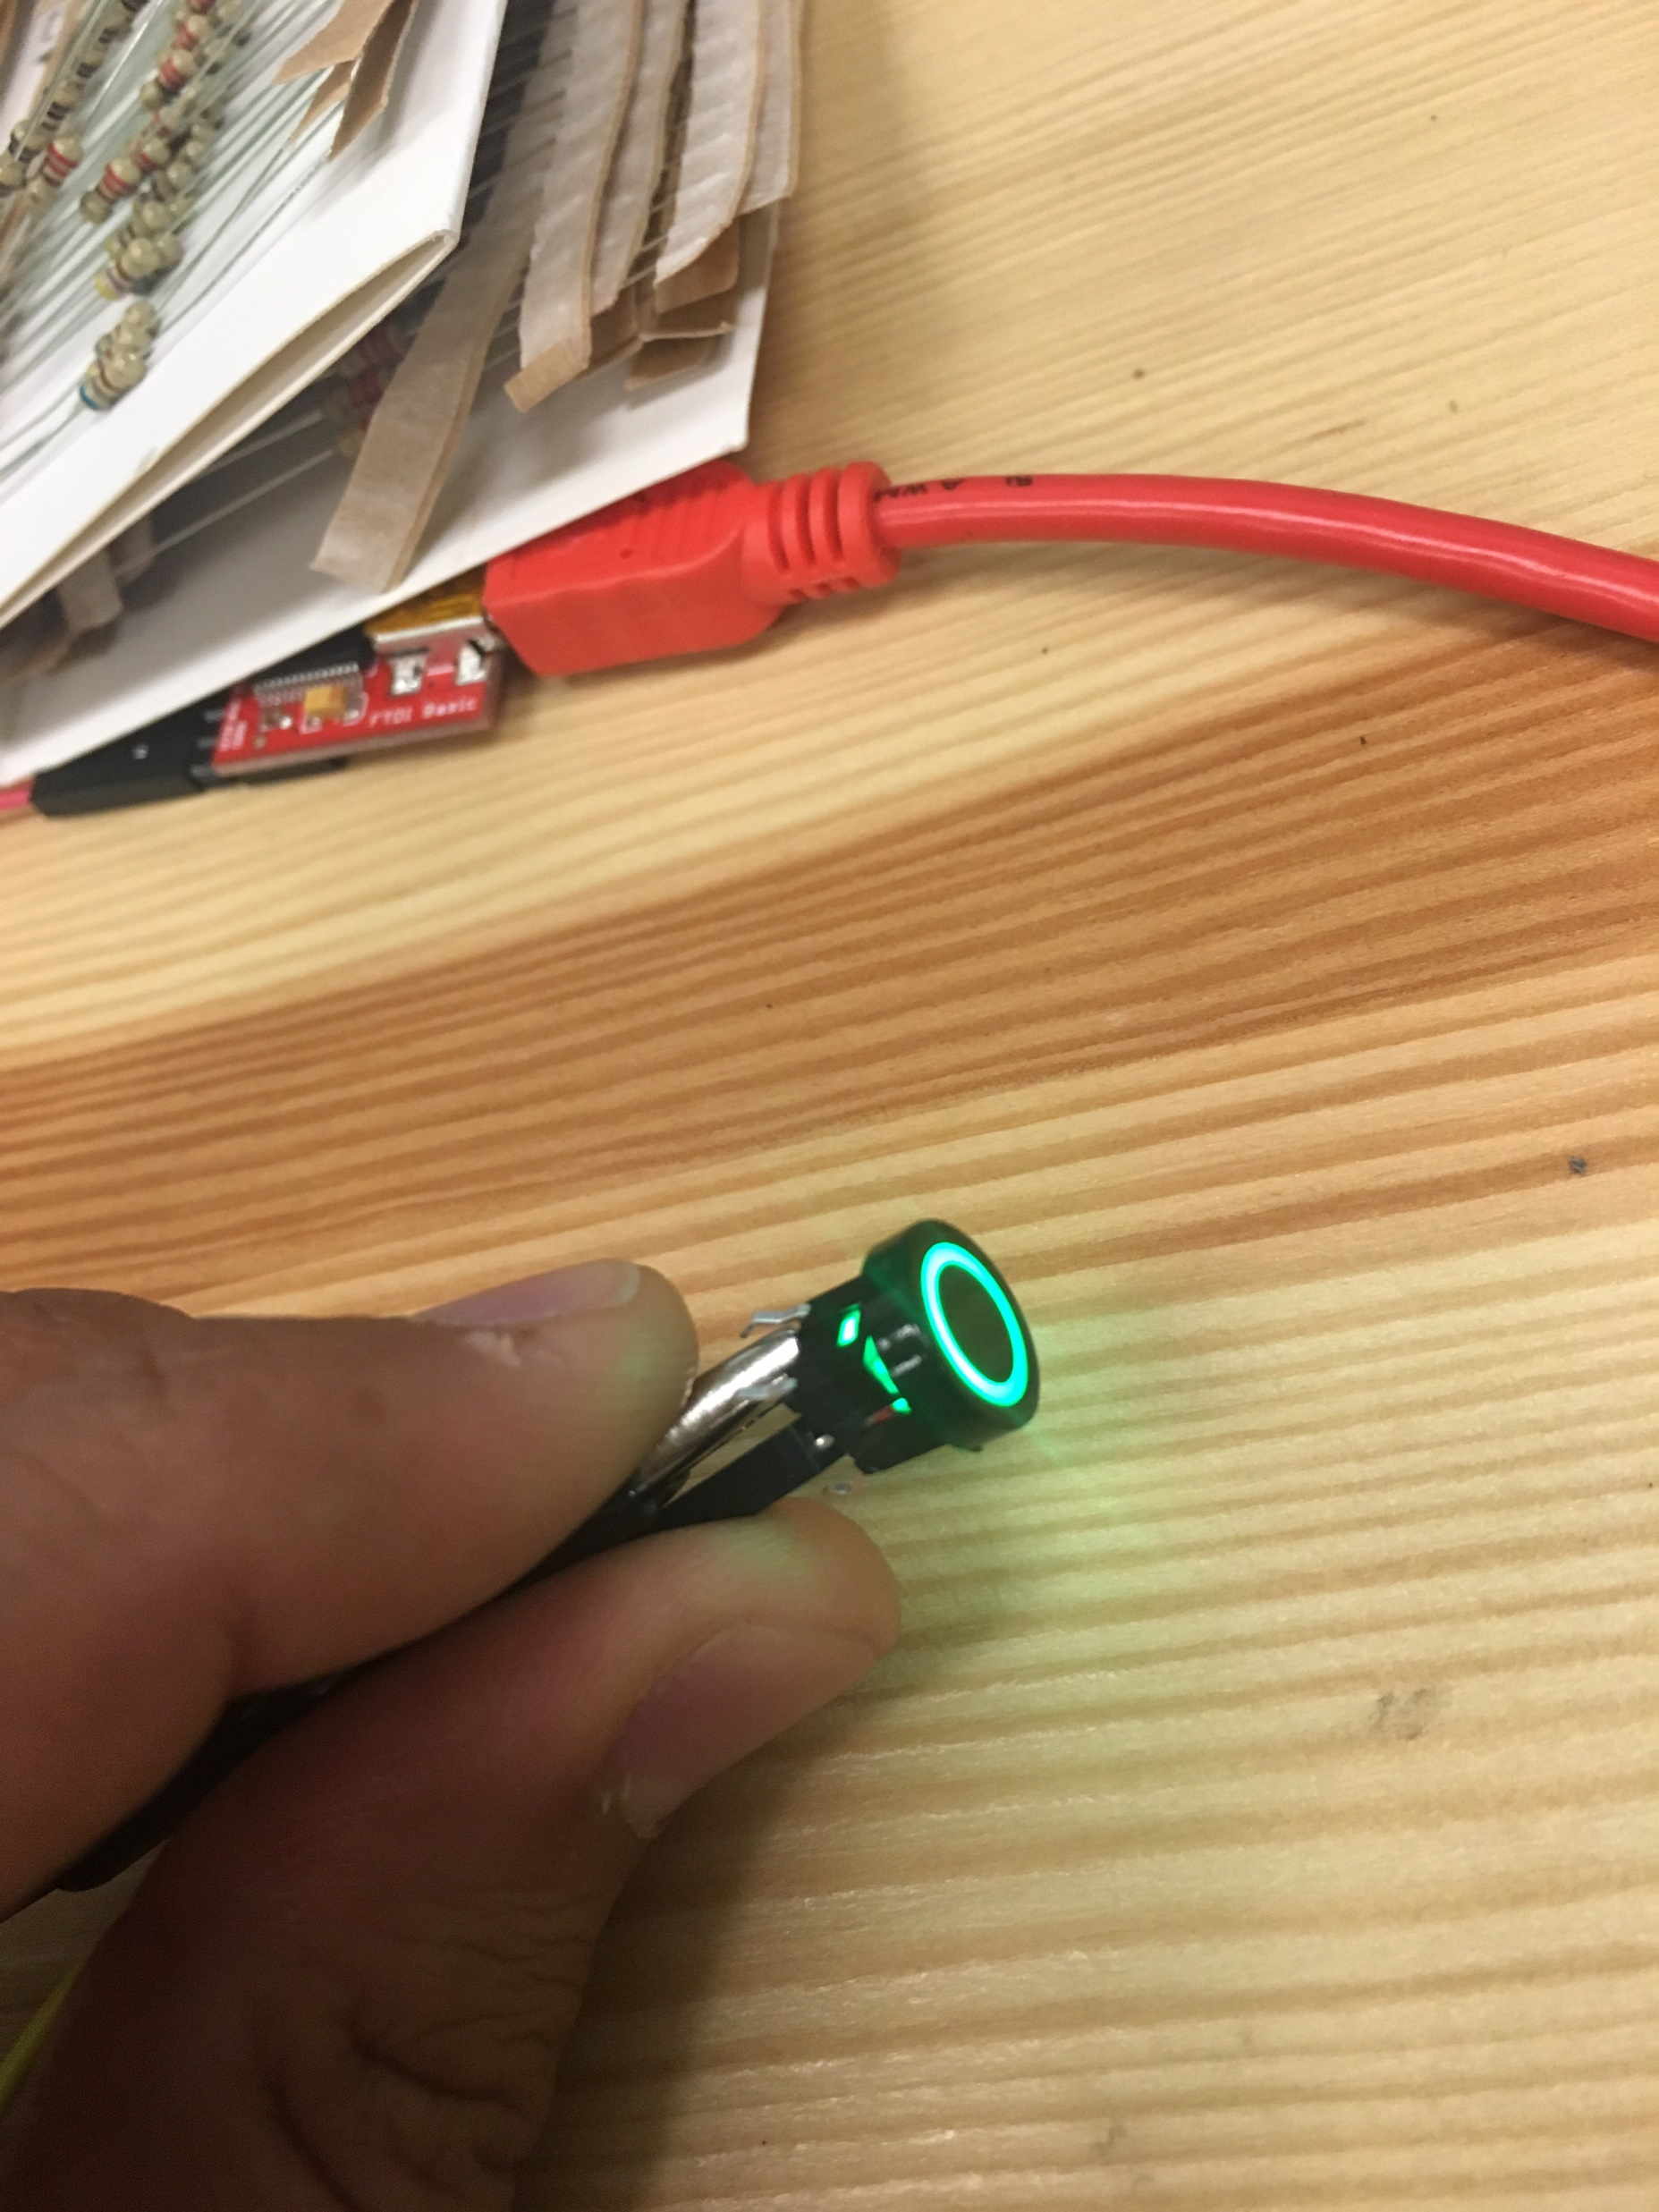
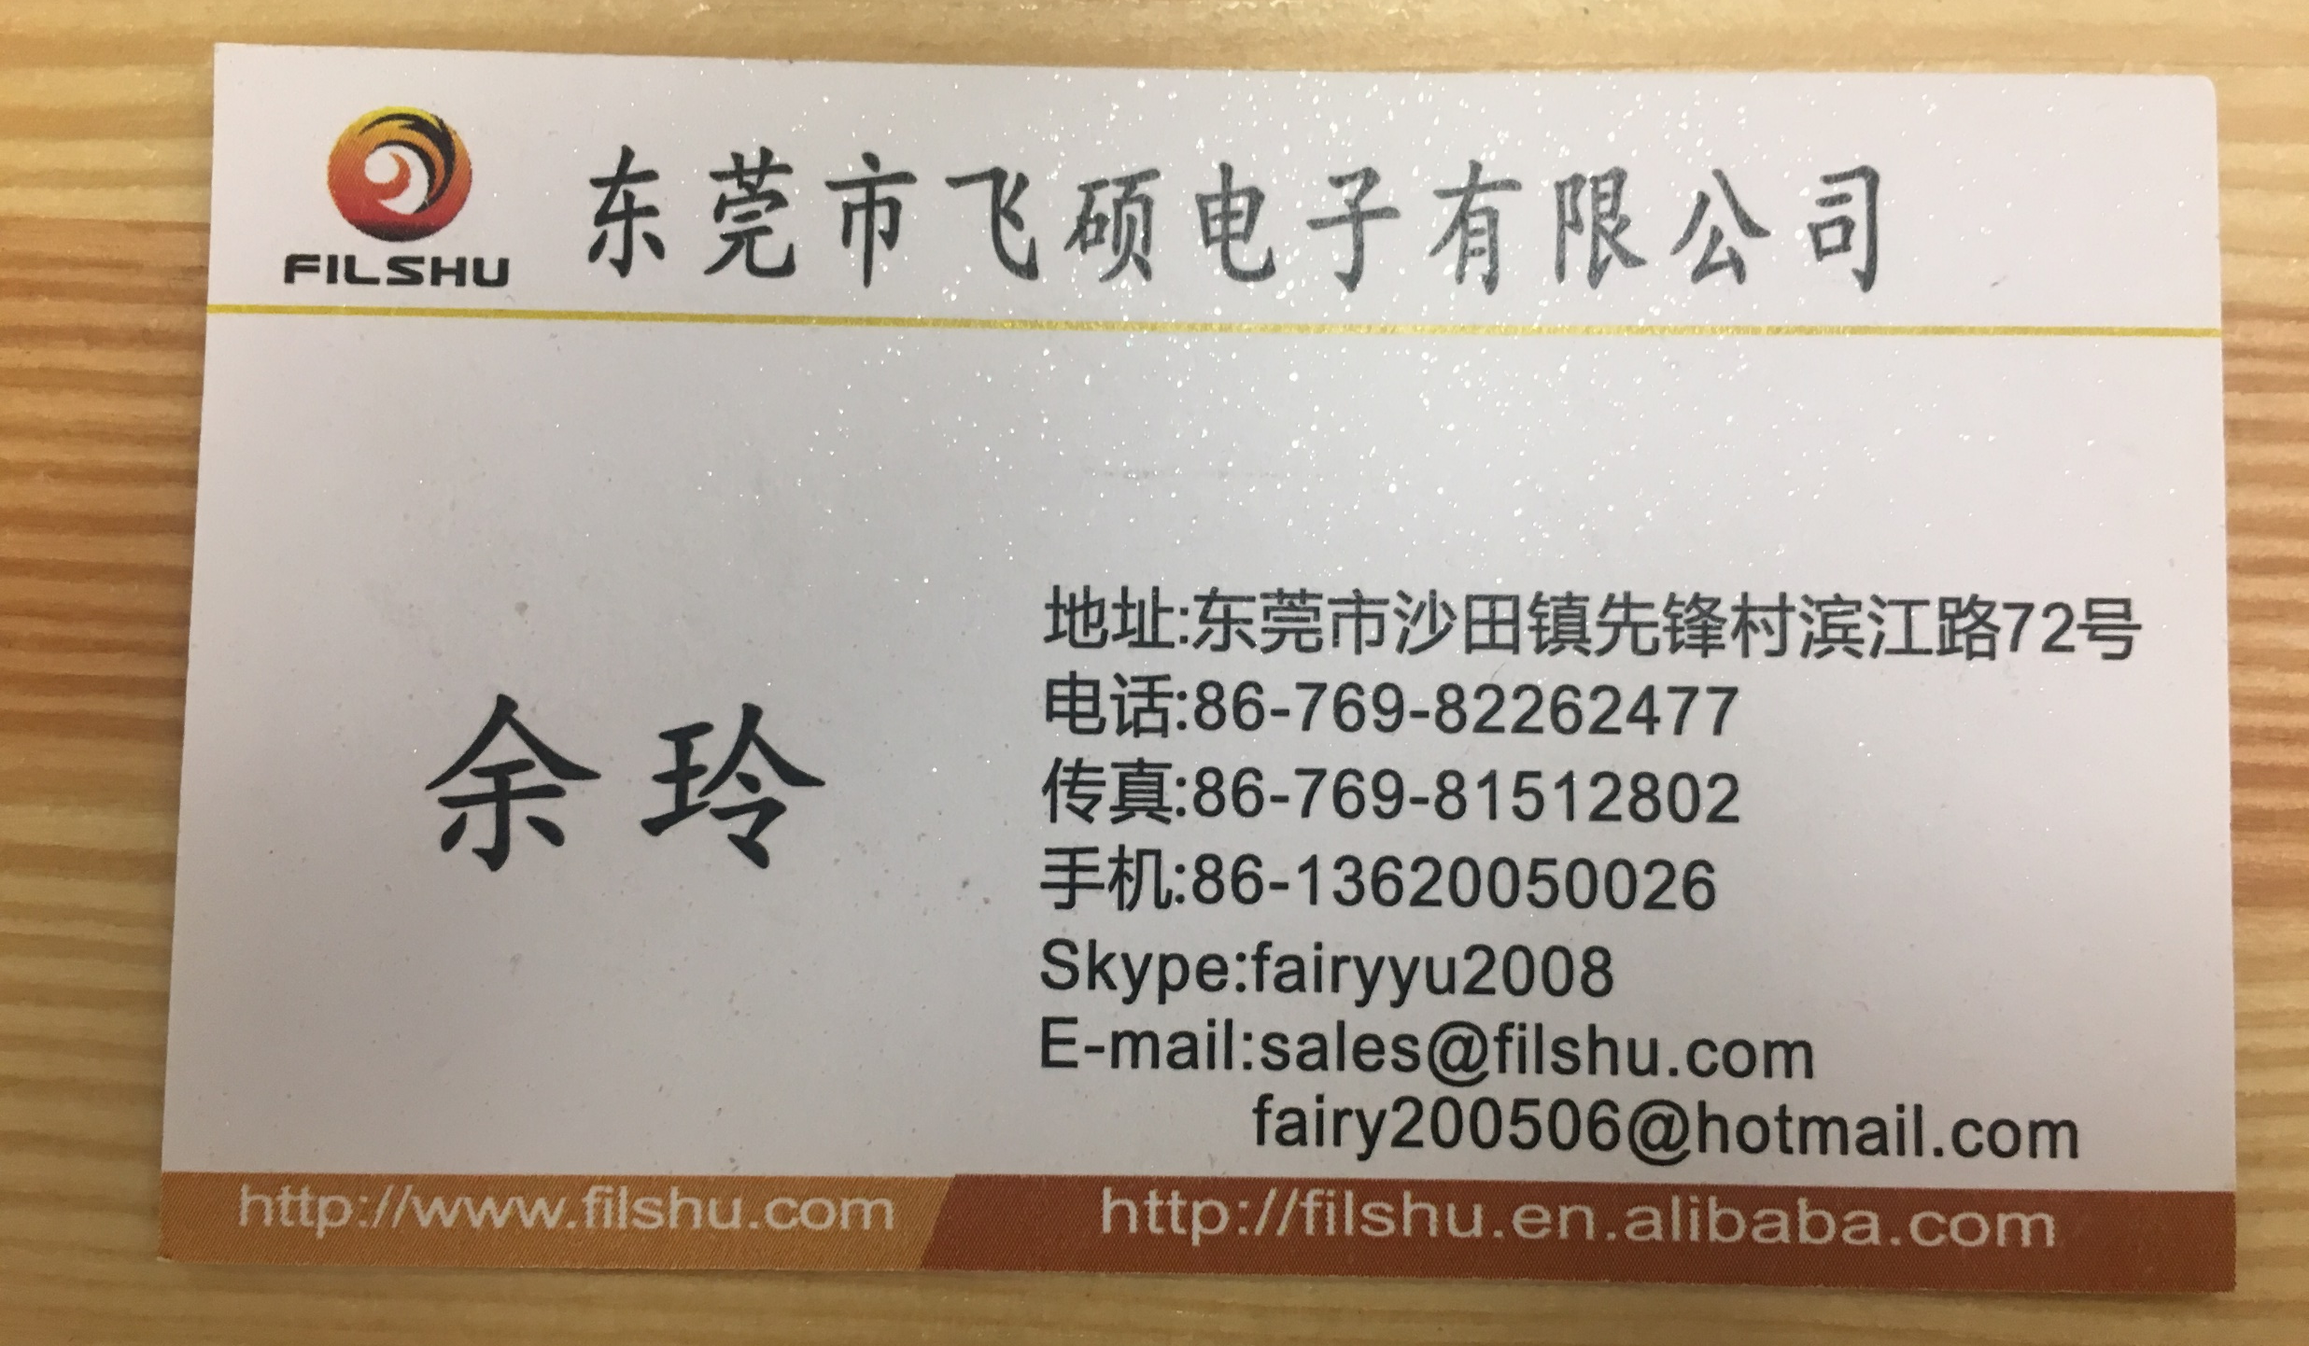
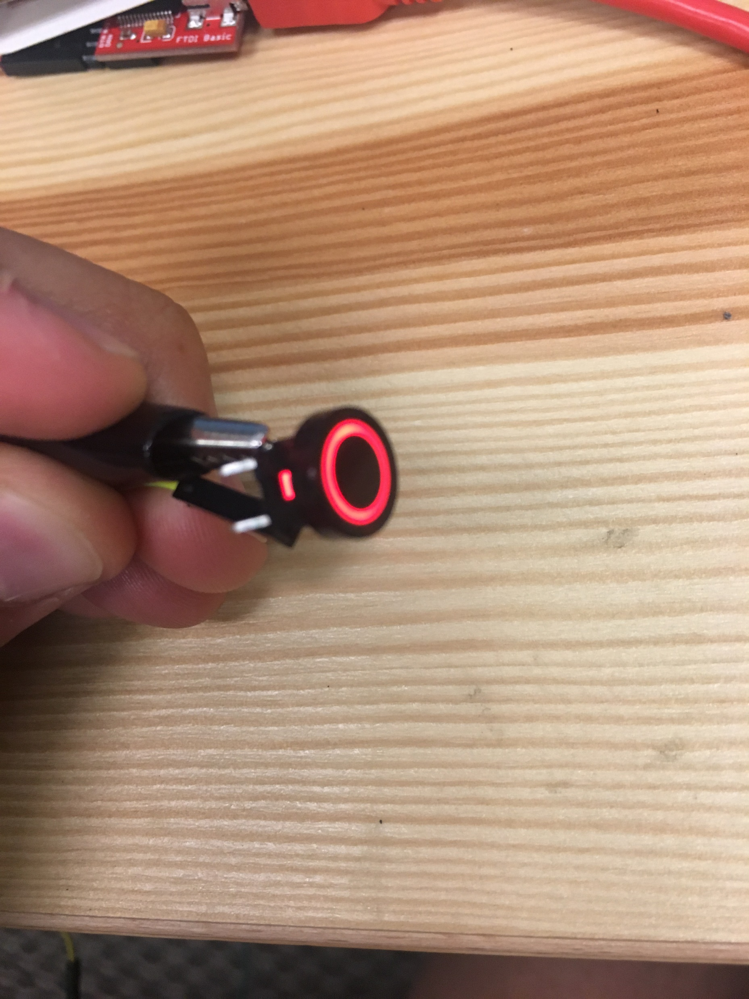
Double Click Icon Above for datasheet
Momentary Switch with Bi-Color LED

Slide 2
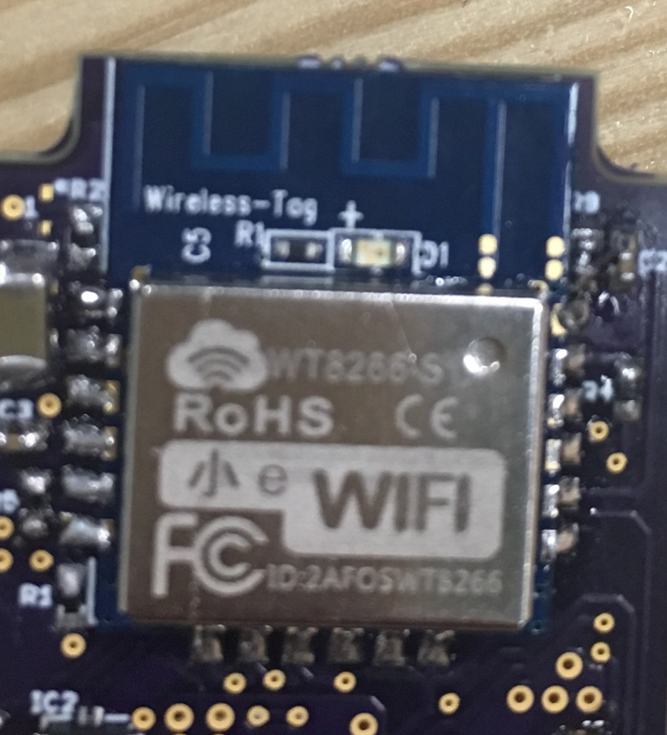
Wireless Tag WT8266-S1
Double Click Icon Above for datasheet

